Slide 1
Research on THC-HYDRA
Presented by: Alish Mahat
Student ID: 23000965
Module: Security and Forensics Tools

Slide 2

Table of Contents
Introduction
Purpose and Applicability
Alternatives
Comparison with Medusa and Ncrack
Strengths
Weaknesses and Limitations
Future Enhancements
Demonstration and Case Study
Will I Use THC-Hydra?
Conclusion and Recommendation
References

Slide 3
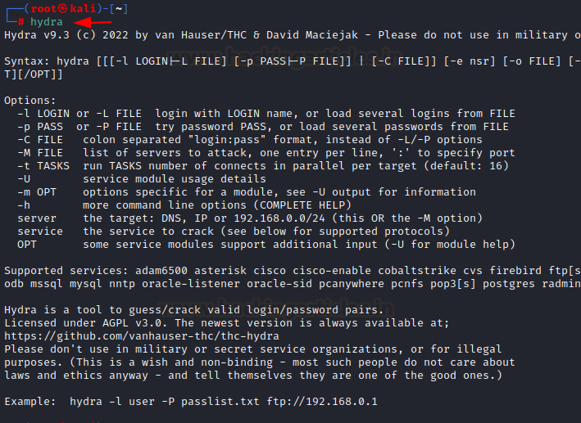
Introduction
THC-Hydra is a powerful, fast, and flexible network login cracker.
It is open-source and supports numerous protocols like FTP, SSH, HTTP, RDP, etc.
Used to test login credentials via brute-force or dictionary attacks.

Slide 4
Purpose and Applicability
Main purpose: Identify weak login credentials.
Used by ethical hackers, penetration testers, and security auditors.
Applicable for login security tests in multiple network environments.

Slide 5
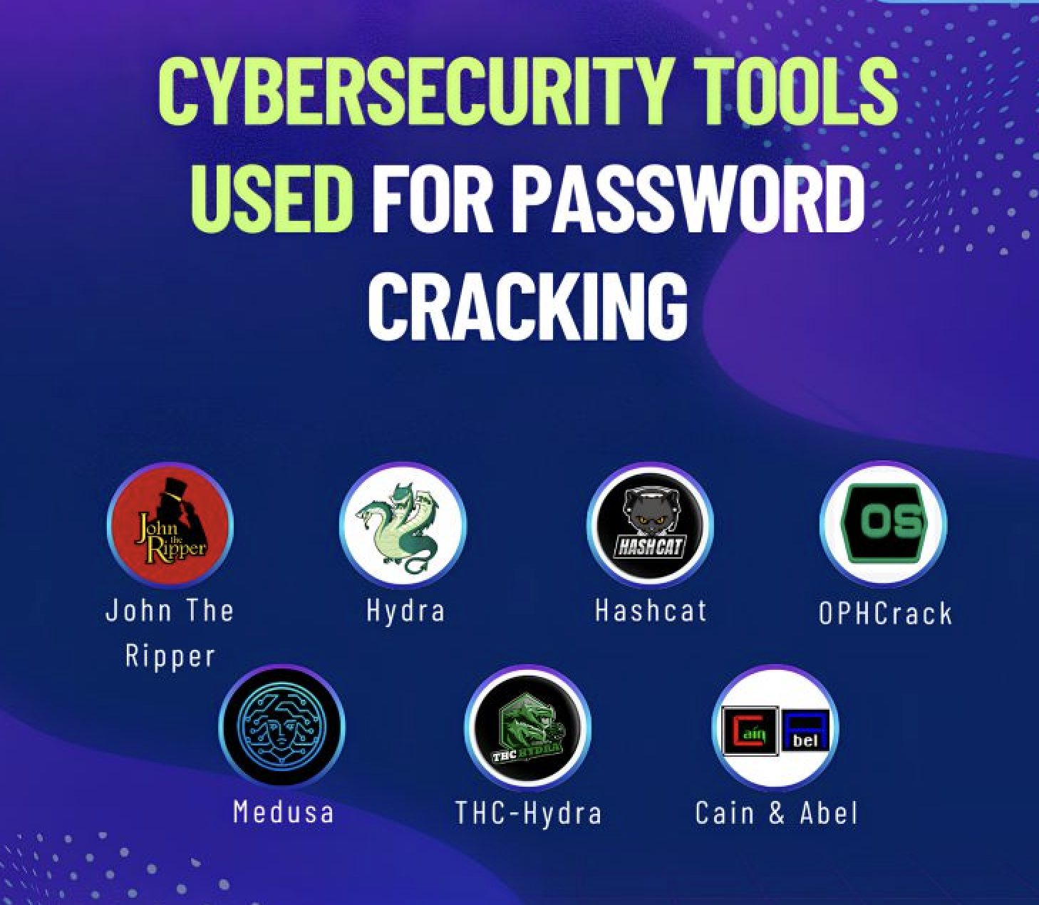
Alternatives
Medusa - Similar to Hydra but older and less active.
Ncrack - Built for SSH/RDP, limited protocol support.
Patator - Modular brute-force tool, slower but flexible.

Slide 6
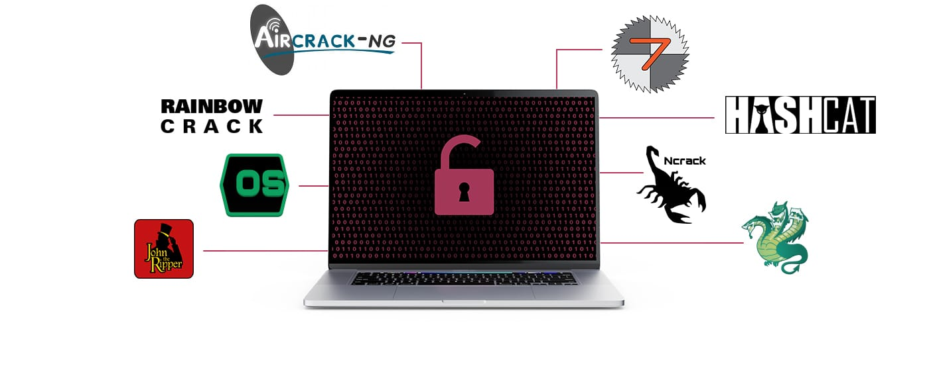
Comparison with Medusa and Ncrack
Hydra: High-speed, protocol-rich, command-line based.
Medusa: Similar speed, less active development.
Ncrack: Specialized for SSH/RDP, fewer options, simpler interface.

Slide 7

Strengths
Supports wide range of protocols.
Highly customizable and scriptable.
Parallel connections for fast cracking.
Regularly updated and widely used.

Slide 8
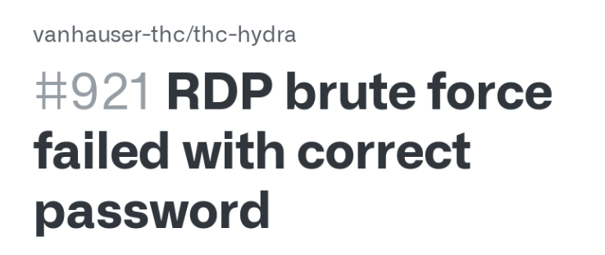

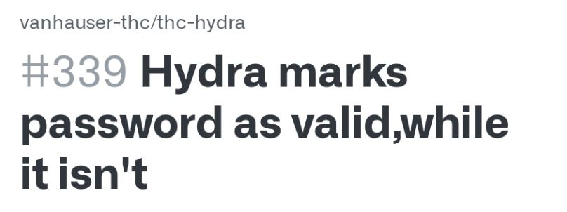
Weaknesses and Limitations
No GUI (command-line only).
May trigger IDS/IPS during scan.
Requires quality wordlists to be effective.
No built-in reporting or result visualization.

Slide 9
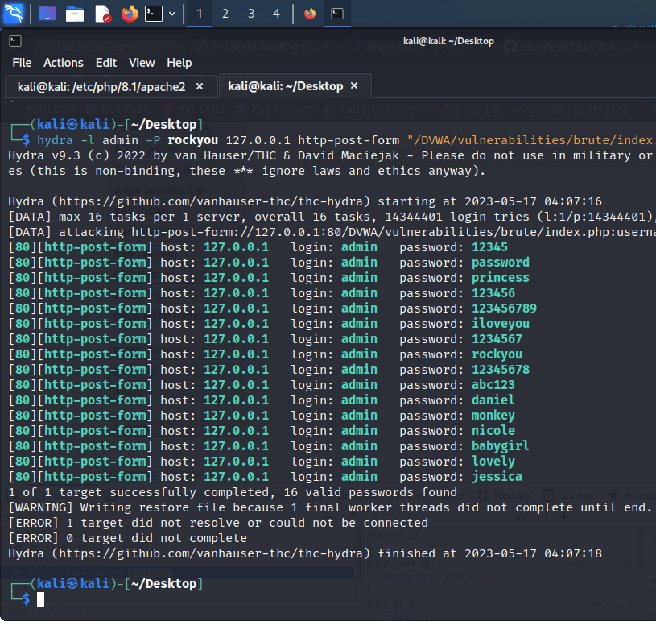
Future Enhancements
Add a cross-platform GUI frontend.
Improve log reporting and export formats.
Introduce detection evasion modes.
Integrate leaked password databases for smart guessing.

Slide 10
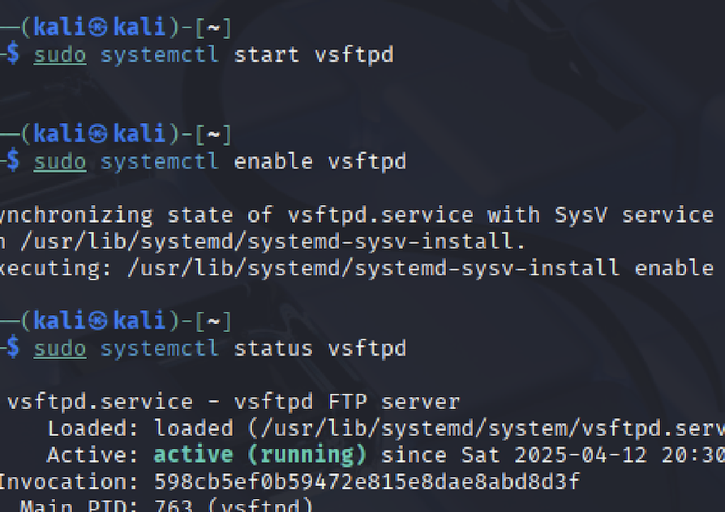
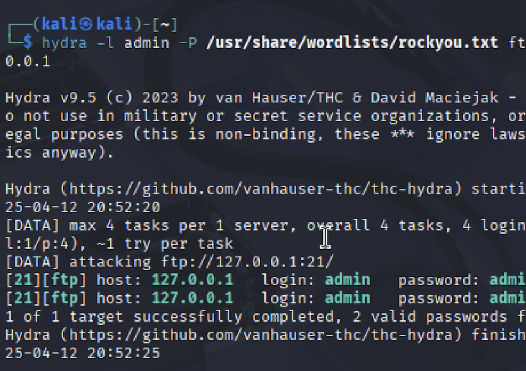
Demonstration and Case study
Target: Local FTP server.
Command: hydra -l admin -P rockyou.txt ftp://127.0.0.1
Hydra uses a dictionary to try logins.
Output shows success when password is found.
This demonstrates Hydra's capability for credential testing.

Slide 11

Will I Use THC-Hydra?
YES – it's fast, reliable, and feature-rich.
Ideal for red team and internal security testing.
Powerful tool when used ethically and legally.

Slide 12

Conclusion and Recommendation
Hydra is a vital tool for network security testing.
Despite some CLI limitations, its power is unmatched.
Continued development ensures future-proof capability.
Highly recommended for professional use.

Slide 13

References
https://github.com/vanhauser-thc/thc-hydra
https://sectools.org/tool/hydra/
https://null-byte.wonderhowto.com/how-to/use-hydra-crack-remote-authentication-servers-0149619/
https://linuxhint.com/hydra_tool_examples/

Slide 14



